Slide 1


Slide 2


Ship As A Digital Enterprise
Generating Value in Maritime Operations

Slide 3

Agenda
Brief introduction
Who we are
Workflow
Quick demo of most important screens
Questions

Slide 4
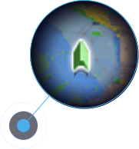


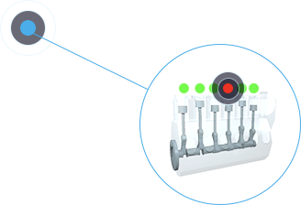
Our Vision
Connect, illuminate and unlock the maritime world for a sustainable future

Slide 5




AlphaOri Product Offerings
IOT / Big Data Platform and applications
Software only application for commercial operations
ERP Software for ship management

Slide 6



Scaled Optimisation for Planet, People and Profit
Software only application leveraging on accurate hull model, noon reports and weather information to provide decision support for optimization or CP compliance as needed
Inspiration From
4+ years with SMARTShip
300+ cargo vessels
Interactions with
Charterers
1
Environment and Compliance
2
Fuel/Performance Optimization
3
$ Earnings
Fleet Operators
Traders

Slide 7
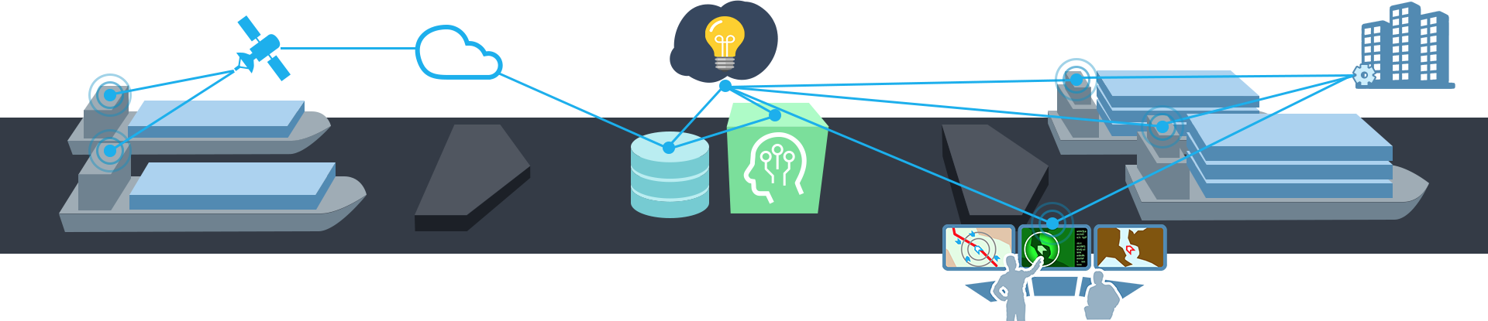
Easy to use Wx Routing, voyage optimization & analysis platform
Collect & Validate
Noon report data + AIS + Live weather info
Analyze & Optimize
Contextual insights and data driven decision making
Monitor & Report
Voyage performance - Operational support

Slide 8


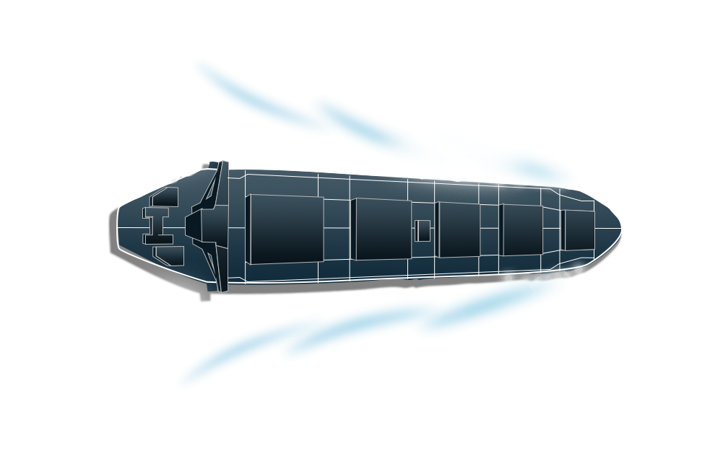





Features & Application
VOYAGE OPTIMISATION
Patented AI based optimisation algorithm, includes Wx routing and provides multiple options
VOYAGE PERFORMANCE
Live monitoring & decision support for prompt intervention
COMMERCIAL DASHBOARD
Detailed view on commercial performance and advice on optimization or CP compliance
SUSTAINABILITY APP
Automatic EEOI/CII ratings dashboard with benchmarking and insights on voyage speed
SMART REPORTS
Automated voyage reporting with analytics - before, during and after completion.
HULL PERFORMANCE APP
Automated hull monitoring and cleaning advice. Speed cons tables for clean and current hull

Slide 9
SMARTVoyager - Quick Reference Guide

Slide 10
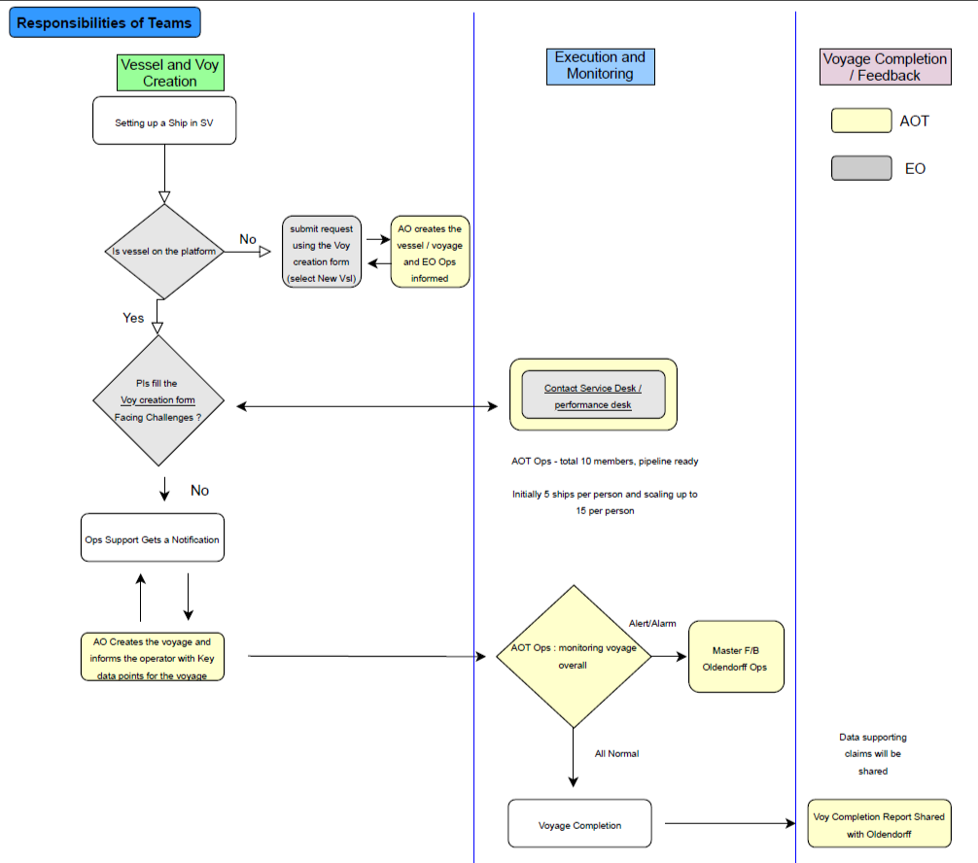
Workflow

Slide 11
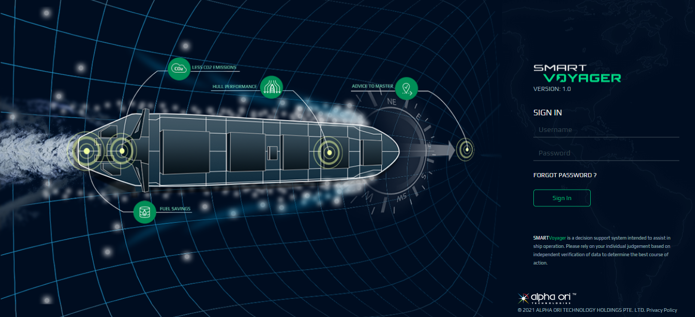
Signing in to the platform
Open a web browser and enter https://sv-oldendorff.alphaorimarine.com.
Enter the following credentials:
User Name - Enter the SMARTVoyager user ID.
Password - Enter the SMARTVoyager password.
Click Sign In.

Slide 12
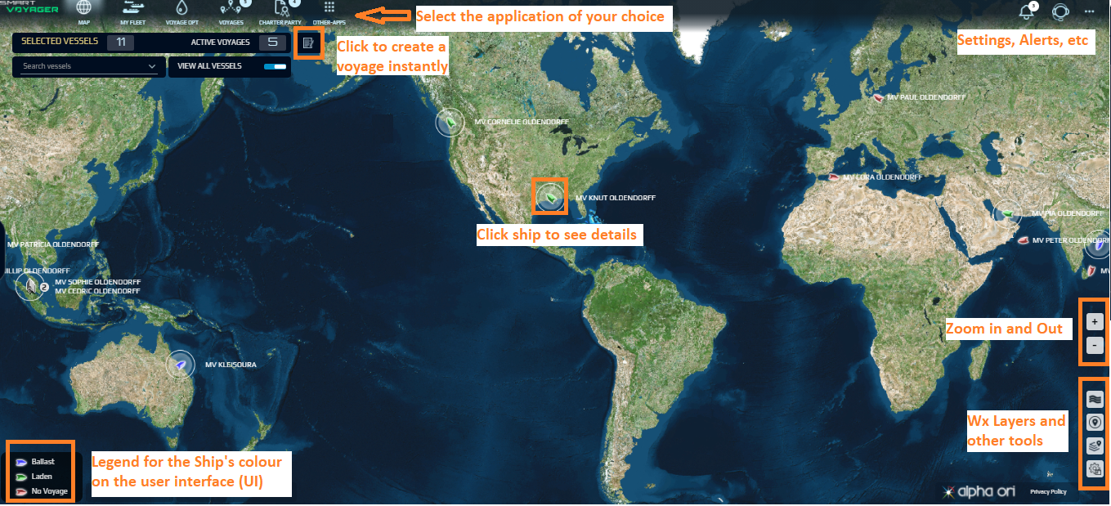
Landing Page - Map View
The map area displays the position of the vessels based on the last received AIS data.

Slide 13
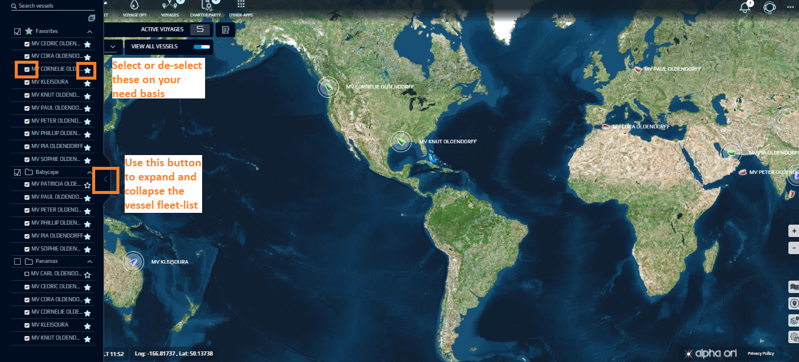
Selecting the ships that you want to follow
Notes: You can select to view a ships data without making them your favorite also. Checkbox is used for this purpose. You will get any notifications for your favourite ships only.

Slide 14
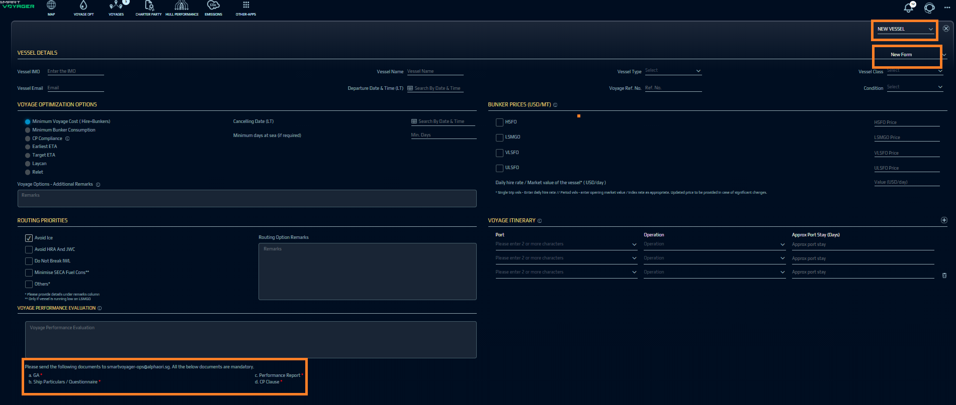
Voyage / Vessel Creation

Slide 15
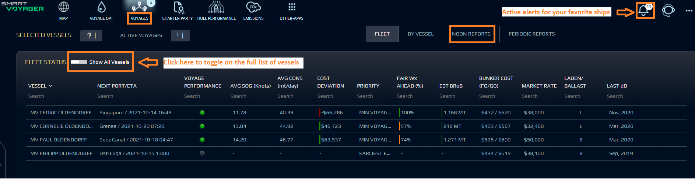
Daily monitoring of your ships
Notes: Voyage performance and cost deviation show more details on hover

Slide 16
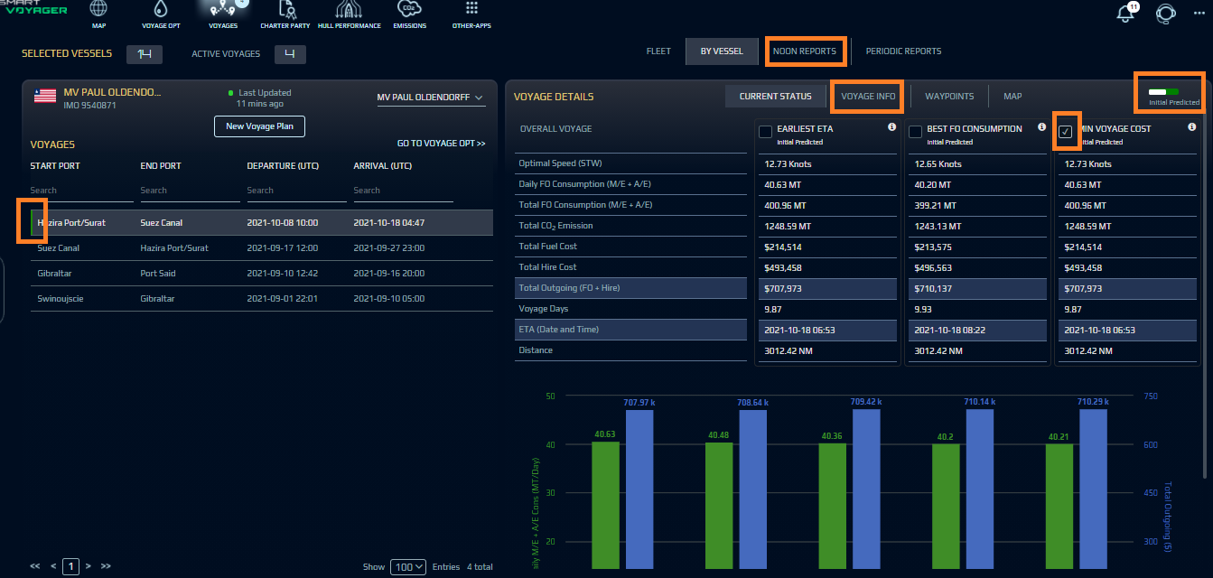
Daily monitoring of your ships - Vessel view

Slide 17
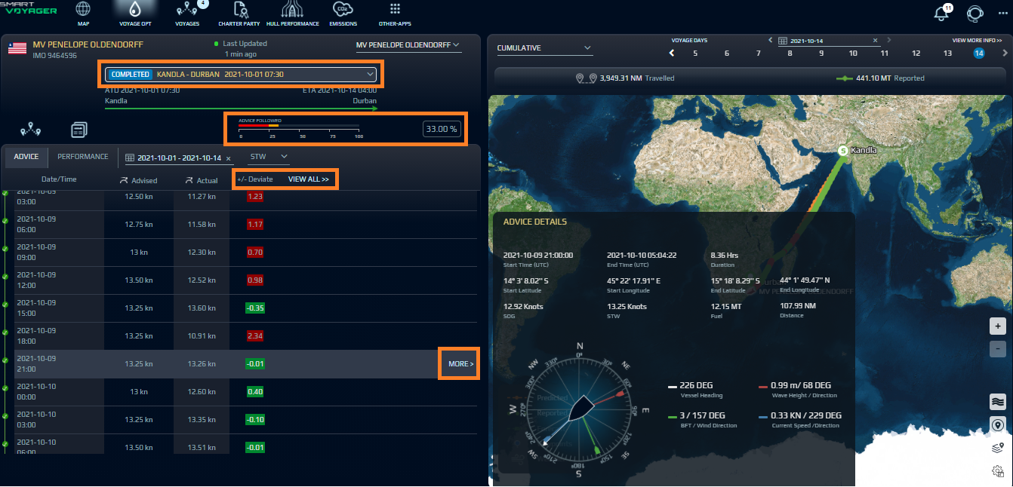
Voyage Opt - Vessel view

Slide 18
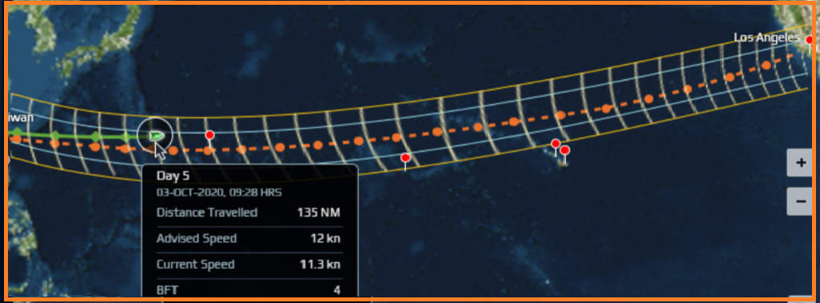
Voyage Opt - More about routing (the grid monitoring

Slide 19
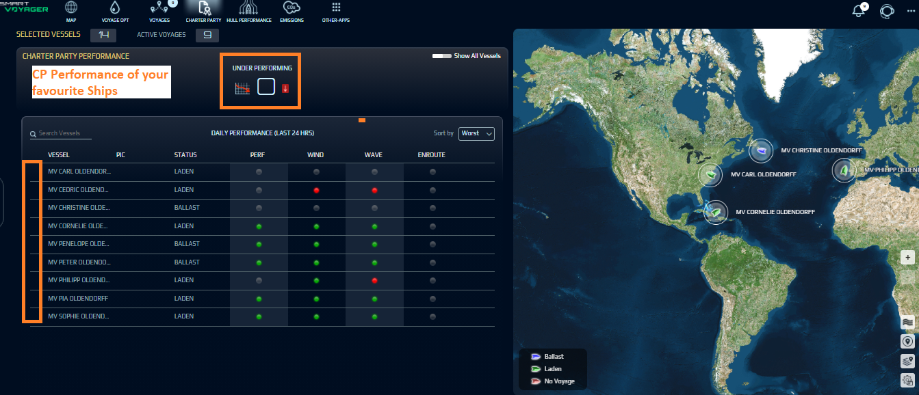
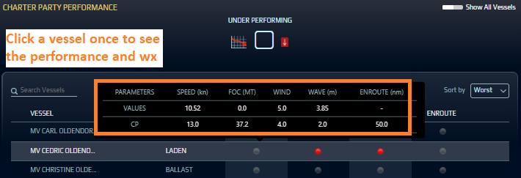
CP Module - Fleet View

Slide 20
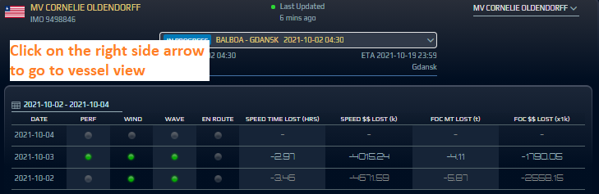
CP Module - Details at ship level

Slide 21
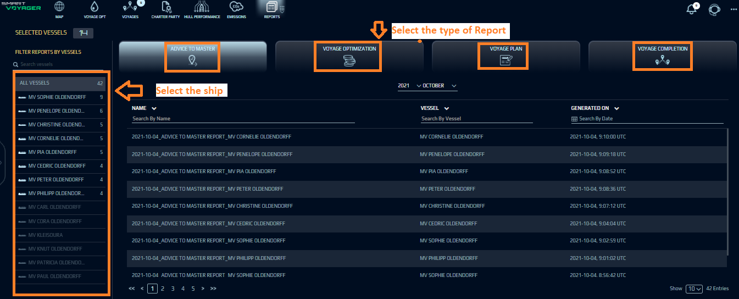
Various Reports

Slide 22
Questions ?
Please feel free to reach out to smartvoyagersupport@alpahori.sg for additional questions

Slide 23
Thanks!

Slide 24
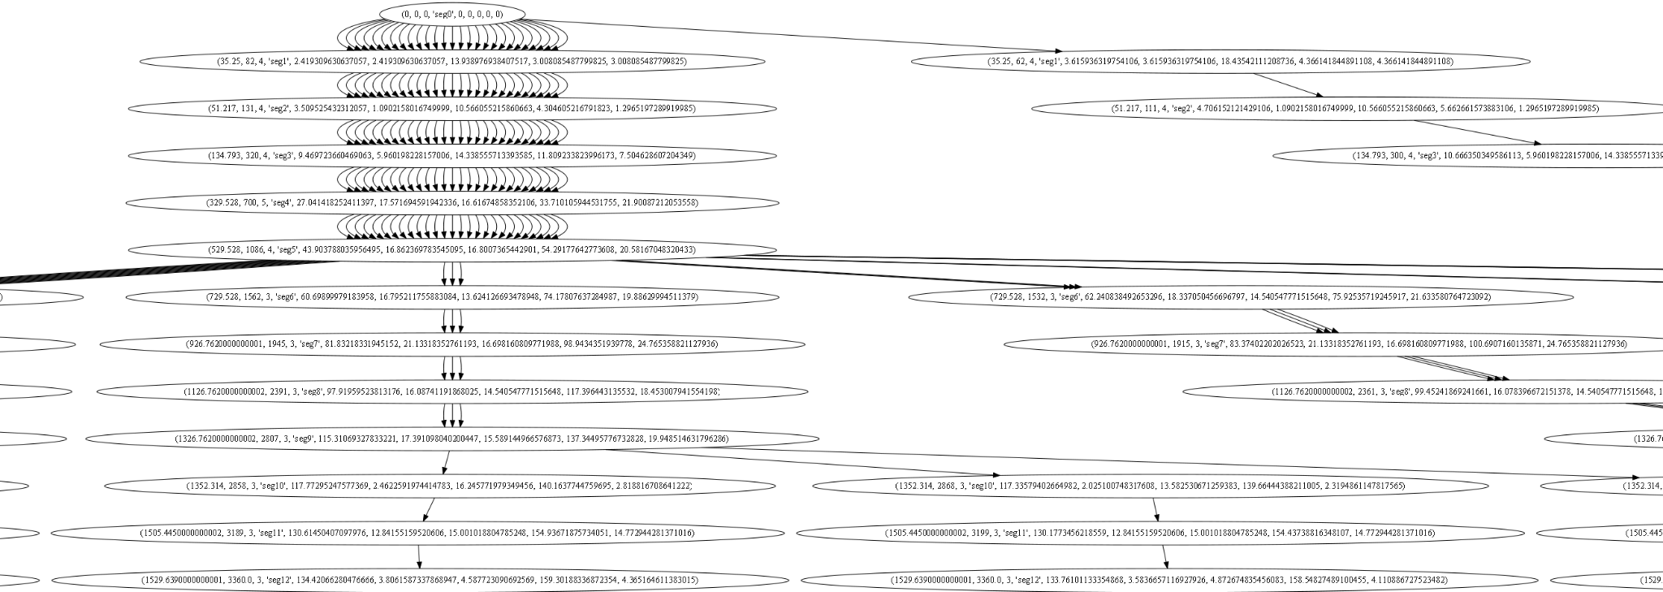
Optimization algorithm_cropped section of network options
At the beginning of the voyage and at every noon - all possible weather and speed combination are evaluated to arrive at optimized speed advice from current location till till the end of the voyage

